Slide 1

Advance Database Programming

Slide 2
Topics
Normalization
Store Procedure
Function
View
Cursor
Notes:
2

Slide 3

Normalization
What is …
Why we use…
Where we use…
Notes:
3

Slide 4
Normalization
Normalization is a process of organizing the data in database to avoid data redundancy, insert, update, deletion commonly. Let’s discuss about anomalies first then we will discuss normal forms with examples.
Here are the most commonly used normal forms:
First normal form(1NF)
Second normal form(2NF)
Third normal form(3NF)
Notes:
4

Slide 5
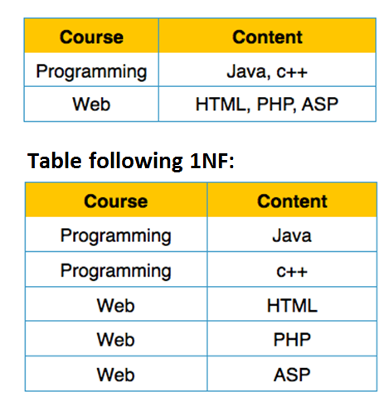
First normal form(1NF)
Notes:
5

Slide 6
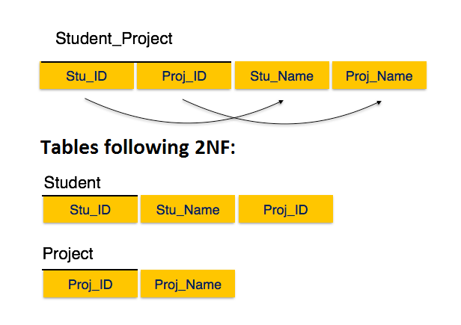
Second normal form(2NF)
Notes:
6

Slide 7
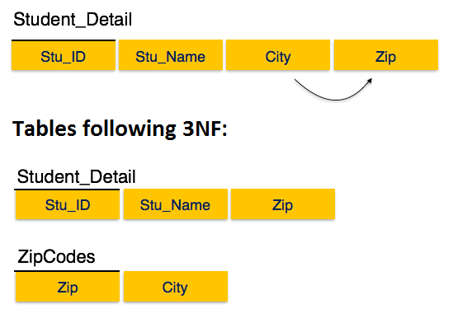
Third normal form(3NF)
Notes:
7

Slide 8
Stored Procedure
What is …
Why we use…
Where we use…
Notes:
8

Slide 9
Stored Procedure
A stored procedure is a set of one or more SQL statements that are stored together in database.
Advantages:
Reusability
Query auto-parameterization
Encapsulation of business rules and policies
Consistent, safe data modification
Improved security
Notes:
9

Slide 10
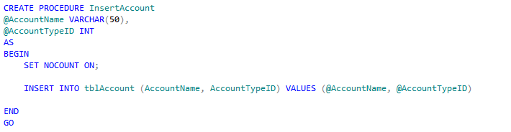
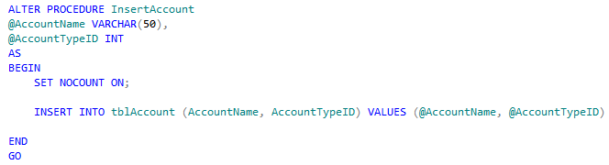
Stored Procedure
Notes:
10

Slide 11
View
What is …
Why we use…
Where we use…
Notes:
11

Slide 12
View
In SQL, a view is a virtual table based on the result-set of an SQL statement.
A view contains rows and columns, just like a real table. The fields in a view are fields from one or more real tables in the database.
Notes:
12

Slide 13
View
Advantages:
View the data without storing the data into the object.
Restrict the view of a table i.e. can hide some of columns in the tables.
Join two or more tables and show it as one to user.
Restrict the access of a table
Disadvantages:
Can not use DML operations on this.
When the table is dropped view becomes inactive.
It is an object so it occupies space.
Adding new columns in table doesn't effect to view.
Notes:
13

Slide 14
Function
What is …
Why we use…
Where we use…
Notes:
14

Slide 15
Function
Function is a Transact-SQL or common language runtime (CLR) routine that accepts parameters, performs an action, such as a complex calculation, and returns the result of that action as a value. The return value can either be a scalar (single) value or a table.
Notes:
15

Slide 16
Function
Types of Functions:
Scalar function
Return a single value.
In Line Table function
Return a single table variable that was created by a select statement.
Multi-statement Table function
Returns a table variable whose structure was created by hand, similar to a Create Table statement.
Ref.: http://stackoverflow.com/questions/2554333/multi-statement-table-valued-function-vs-inline-table-valued-function
Notes:
16

Slide 17
Function
Advantages:
It permits calculations that are too complex, awkward, or unavailable with SQL.
Function can be used in a Select, Where or Case statement.
Function can be used to create joins.
Simple to invoke from inside another SQL statement.
Disadvantages:
Function cannot be used to modify base table information. The DML statement INSERT, UPDATE and DELETE can't be used on base tables.
Notes:
17

Slide 18
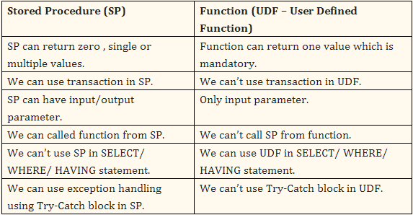
Stored Procedure V/S Function
Notes:
18

Slide 19
Cursor
What is …
Why we use…
Where we use…
Notes:
19

Slide 20
Cursor
A Cursor is a database object that represents a result set and is used to manipulate data row by row.
When a cursor is opened, it is positioned on a row and that row is available for processing.
Considerations before using a Cursor: 1. Think of all possible alternatives to solve your problem and if you didn't got any then create a cursor. 2. Consider Temp tables as alternatives to usage of cursors.
Notes:
20

Slide 21
Cursor
Advantages:
Row by Row operations can be successfully executed.
Disadvantages:
Performance degradation on the usage of cursors.
It will eat up your memory and hence other parallel processes will suffer too.
Cursors are the SLOWEST way to access data inside SQL Server as it does row by row operations and cursors are over thirty times slower than set based alternatives.
Notes:
21

Slide 22
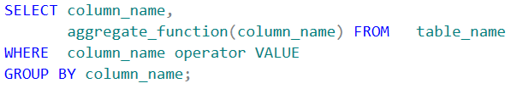
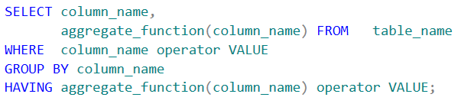
Useful General Functions
Count
Distinct
Group by
Having
Notes:
22

Slide 23


Useful General Functions
Min/Max
Top
Row_Number
Notes:
23

Slide 24
Advance Database Programming
THANK YOU
ANY QUESTIONS ?
Notes:
24
24

